Slide 1
Shift Microoperations

Slide 2
Microoperations
A microoperation is an elementary operation performed with the data stored in registers.
The microoperations most often encountered in digital computers are classified into four categories:
  Register transfer microoperations (on binary information)
  Arithmetic microoperations (on numeric data stored in the registers)
  Logic microoperations (bit manipulations on non-numeric data)
  Shift microoperations

Slide 3
Shift Microoperations
Shift microoperations are used for serial transfer of data.
The Shift microoperations that specify a 1-bit shift to the left of the content of register R and a 1-bit shift to the right of the content of register R.
During a shift-left operation the serial input transfers a bit into the rightmost position.
During a shift-right operation the serial input transfers a bit into the leftmost position.

Slide 4
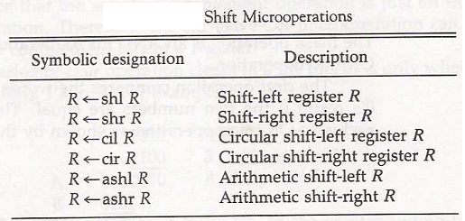
Types of Shift Microoperations
There are three types of shifts Microoperations :
Logical
Circular
Arithmetic

Slide 5
Logical Shift
A logical shift is one that transfers 0 through the serial input.
The symbols shl and shr for logical shift-left and shift-right microoperations.
The bit transferred to the end position through the serial input is assumed to be 0 during a logical shift.

Slide 6
Circular Shift
The circular shift (also known as a rotate operation) circulates the bits of the register around the two ends without loss of information.
This is accomplished by connecting the serial output of the shift register to its serial input.
We will use the symbols cil and cir for the circular shift left and right, respectively.

Slide 7
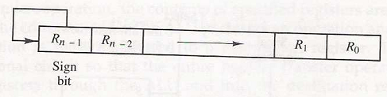
Arithmetic Shift
An arithmetic shift microoperation shifts a signed binary number to the left or right.
An arithmetic shift-left multiplies a signed binary number by 2.
An arithmetic shift-right divides the number by 2.
Arithmetic shifts must leave the sign bit unchanged because the sign of the number remains the same when it is multiplied or divided by 2.
Negative numbers are stored in 2’s complement form.
Fig: arithmetic shift right

Slide 8
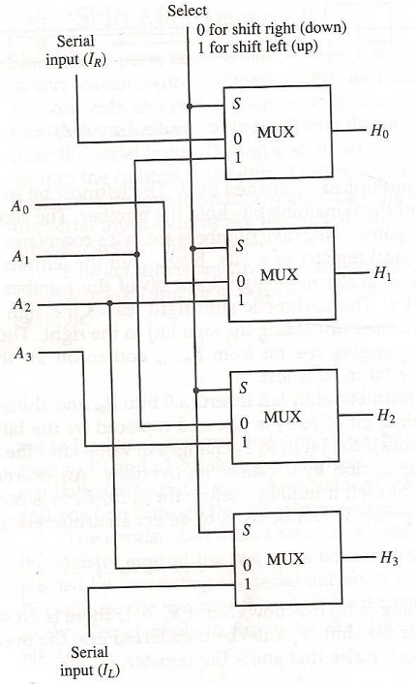
Hardware Implementation
The 4-bit shifter has four data inputs, A₀ through A₃, and four data outputs, H₀ through H₃.
There are two serial inputs, one for shift left (I_{L}) and the other for shift right (I_{R}).
Fig: 4-bit combinational circuit shifter

Slide 9
Hardware Implementation
When the selection input S=0 the input data are shifted right (down in the diagram).
When S = 1, the input data are shifted left (up in the diagram).
A shifter with n data inputs and outputs requires n multiplexers.
Fig: 4-bit combinational circuit shifter

Slide 10
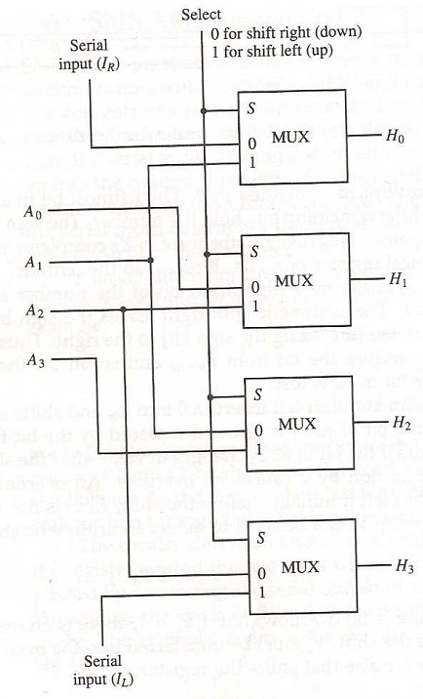
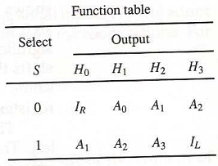
4-bit Combinational Circuit Shifter

Slide 11
Arithmetic Logic Shift Unit
Instead of having individual registers performing the microoperations directly, computer systems employ a number of storage registers connected to a common operational unit called an arithmetic logic unit, abbreviated ALU.
The shift microoperations are often performed in a separate unit, but sometimes the shift unit is made part of the overall ALU.
The arithmetic, logic, and shift circuits can be combined into one ALU with common selection variables.

